Slide 1
Deep Residual Neural Network
STA695-TTF
University of Kentucky

Slide 2
The deeper, the better
The deeper network can cover more complex problems
Receptive field size ↑
Non-linearity ↑
However, training the deeper network is more difficult

Slide 3
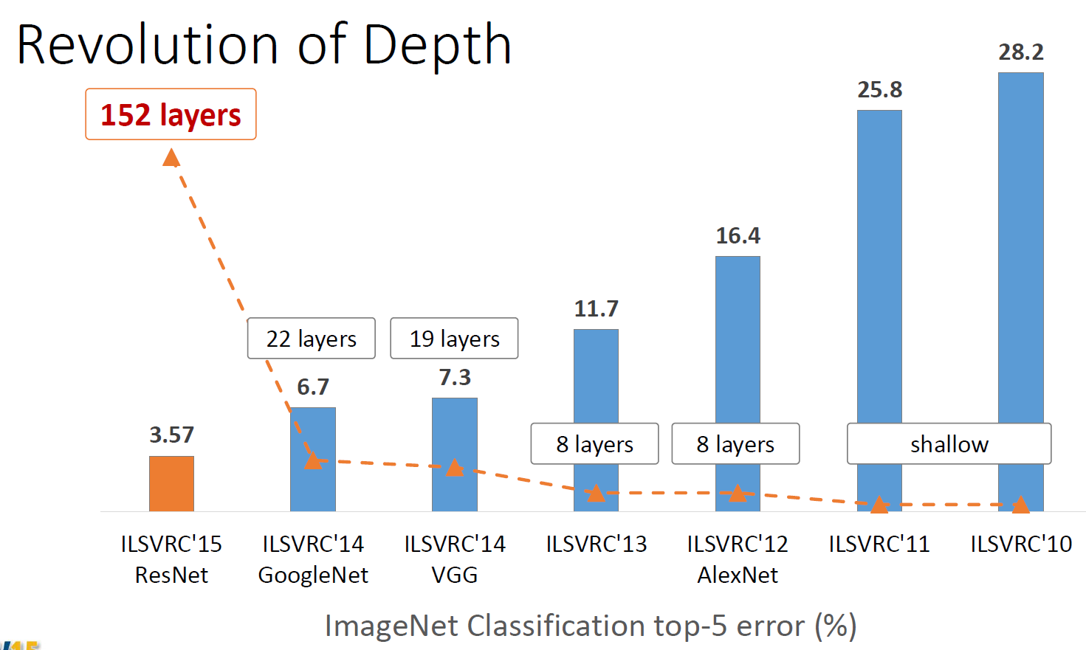
Deep Neural Network
Escape from few layers
ReLU
Dropout …

Slide 4
Deep Neural Network
Escape from 10 layers
Normalized initialization
Intermediate normalization layers

Slide 5
Deep Neural Network
Escape from 100 layers
Residual network

Slide 6

Kaiming He
Dehazing using dark channel prior
Guided image filter
Computer vision using machine learning…

Slide 7
Want to go deeper
As network goes deeper, performance decrease
Why?
Overfitting?

Slide 8
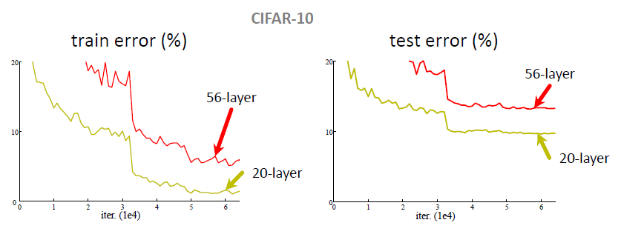
Plain Network
Plain nets: stacking 3x3 conv layers
56-layer net has higher training error and test error than 20-layers net

Slide 9
Plain Network
“Overly deep” plain nets have higher training error
A general phenomenon, observed in many datasets

Slide 10
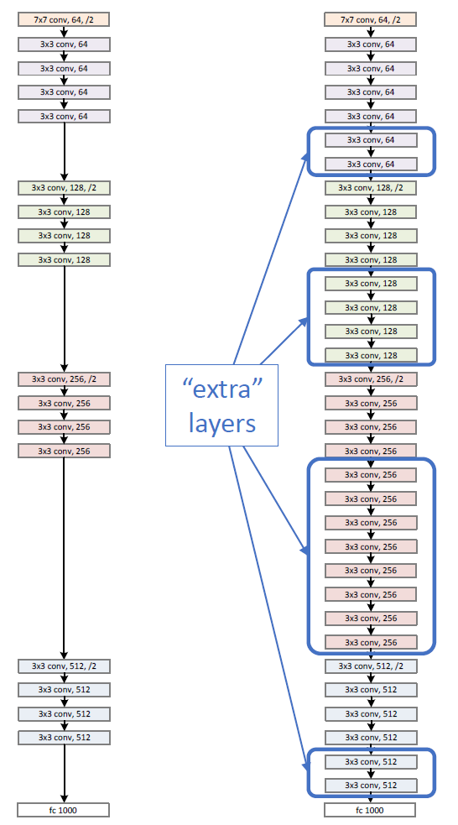
Residual Network
Naïve solution
If extra layers are an identity mapping, then a training errors does not increase

Slide 11
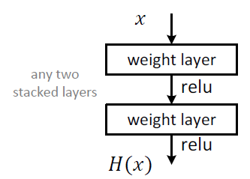
Residual Network
Plain block
Difficult to make identity mapping because of multiple non-linear layers

Slide 12
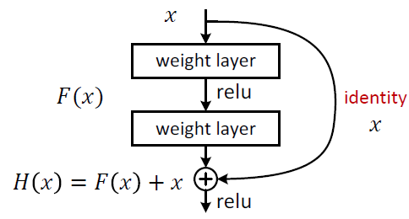
Residual Network
Residual block
If identity were optimal, easy to set weights as 0
If optimal mapping is closer to identity, easier to find small fluctuations
-> Appropriate for treating perturbation as keeping a base information

Slide 13
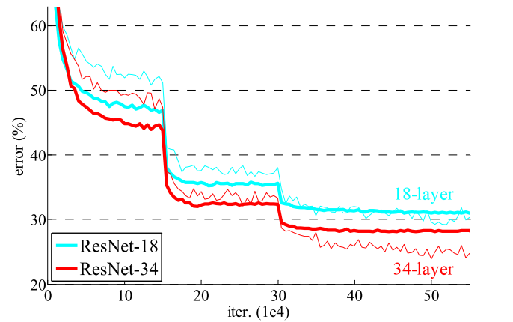
Residual Network
Deeper ResNets have lower training error

Slide 14


Residual Network
Shortcuts connections
Identity shortcuts
Projection shortcuts

Slide 15
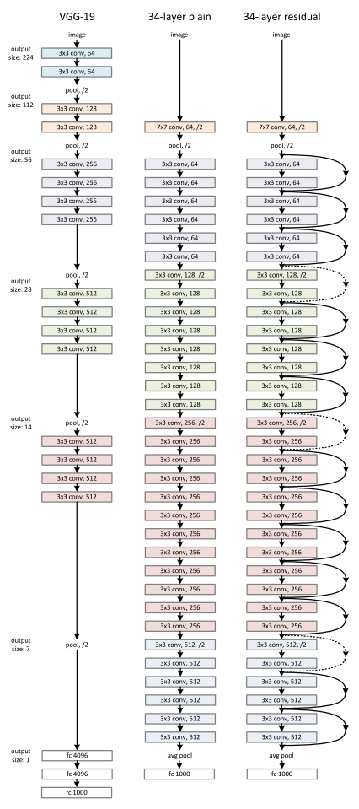
Network Design
Simple design, just deep

Slide 16
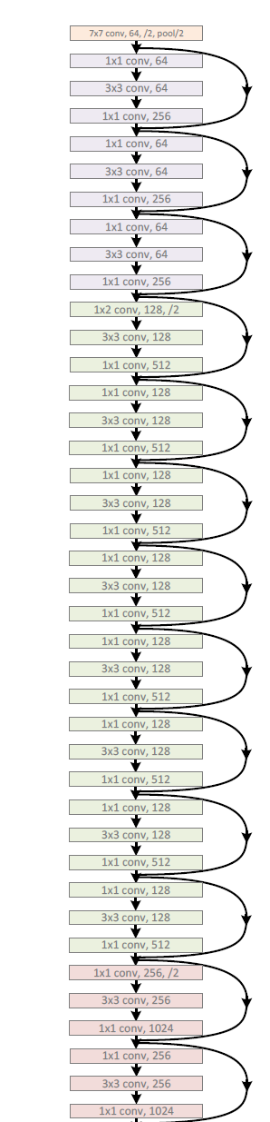
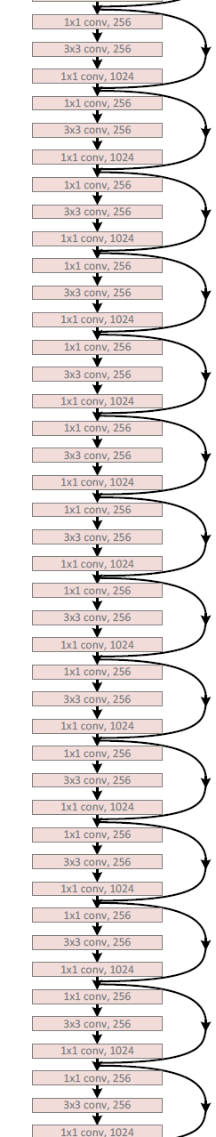
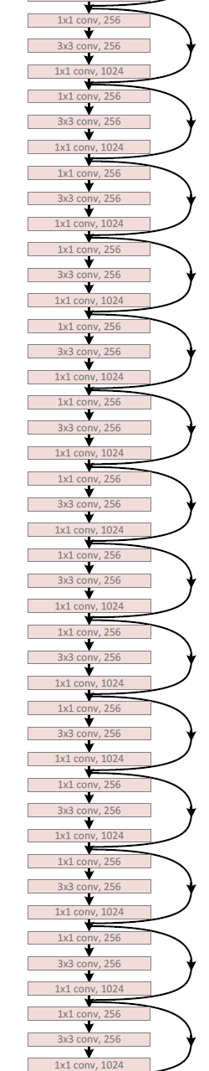
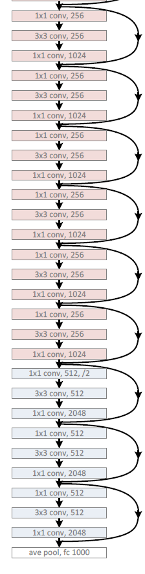
Network Design
ResNet-152

Slide 17
Results
Deep Resnets can be trained without difficulties
Deeper ResNets have lower training error, and also lower test error

Slide 18
Results
Deep Resnets can be trained without difficulties
Deeper ResNets have lower training error, and also lower test error

Slide 19
Results
1st places in all five main tracks in “ILSVRC & COCO 2015 Competitions”
ImageNet Classification
ImageNet Detection
ImageNet Localization
COCO Detection
COCO Segmentation

Slide 20
Quantitative Results
ImageNet Classification

Slide 21
Conclusion
Deeper networks are better expectably
ResNet is very simple
We should use it from now on

Slide 22
Reference
Kaiming He, Xiangyu Zhang, Shaoqing Ren, & Jian Sun. “Deep Residual Learning for Image Recognition”. arXiv 2015.
Slides of Deep Residual Learning @ ILSVRC & COCO 2015 competitions

Slide 23
Thank You

